Slide 1
Barriers to Implementing a Just Culture
By Jordany Gonzalez
Professor Sue Sampson
CSD 380
February 23, 2025

Slide 2
What is Just Culture?
Just Culture promotes a work environment where employees can report errors without fear of punishment. The focus shifts from blame to learning and accountability. It distinguishes between human error, at-risk behavior, and reckless behavior. This approach encourages continuous improvement and ensures both individuals and organizations take responsibility for safety outcomes (Dekker, 2011; PSNet, 2023).

Slide 3
Key Principles
Fairness: Distinguishes between human error and negligence (Dekker, 2011).
Openness: Encourages transparent error reporting (Ingram, 2023).
Learning: Promotes system improvement based on incident reviews (Humanistic Systems, 2023).
Accountability: Ensures responsibility without unfair punishment (PSNet, 2023).

Slide 4
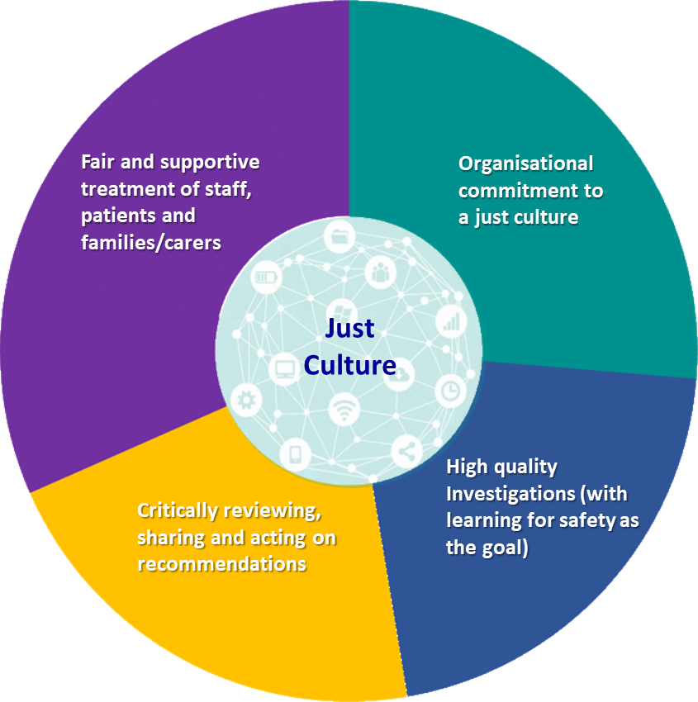
Visual representation
JUST CULTURE

Slide 5
Barriers to Implementation
Fear of Punishment: Employees avoid reporting to avoid disciplinary action (Ingram, 2023).
Lack of Trust: Staff doubt how leadership will handle reported issues (Humanistic Systems, 2023).
Resistance to Change: Long-standing practices make change difficult (PSNet, 2023).
Leadership Commitment: Without strong leadership support, progress stalls (Ingram, 2023).
Resource Constraints: Limited training, systems, and staff time hinder progress (Dekker, 2011).

Slide 6

Impact of Barriers
These barriers undermine open communication, leading to underreporting of incidents, missed learning opportunities, and continued safety risks. Without trust and leadership commitment, Just Culture becomes superficial rather than transformational (Humanistic Systems, 2023; PSNet, 2023).

Slide 7

Overcoming Barriers
Error Reporting System: Develop an easy, non-punitive reporting process (PSNet, 2023).
Training: Educate staff on Just Culture principles and behavior classification (Ingram, 2023).
Leadership Commitment: Leaders must model and enforce Just Culture practices (Humanistic Systems, 2023).
Transparency: Promote open discussions about errors and solutions (Dekker, 2011).
Resource Allocation: Provide time, tools, and personnel for continuous learning (PSNet, 2023).

Slide 8


Case Study Example
Fairview Health Services implemented Just Culture by training staff to differentiate human error from reckless behavior. They partnered with the Minnesota Alliance for Patient Safety and used data-driven feedback to reinforce the culture. This approach led to increased reporting, improved safety, and greater staff engagement (PSNet, 2023).

Slide 9
References
Dekker, Sidney. Just Culture: Balancing Safety and Accountability. Ashgate Publishing, 2011.
Ingram, Chris. "Breaking Down Barriers: Realising a Just Culture in Healthcare Organisations." LinkedIn, 18 Jan. 2023, https://www.linkedin.com/pulse/breaking-down-barriers-realising-just-culture-chris-ingram.
"Why Is It Just So Difficult? Barriers to ‘Just Culture’ in the Real World." Humanistic Systems, 18 Oct. 2023, https://humanisticsystems.com/2023/10/18/why-is-it-just-so-difficult-barriers-to-just-culture-in-the-real-world/.
"Making Just Culture a Reality: One Organization's Approach." PSNet, 1 Mar. 2023, https://psnet.ahrq.gov/perspective/making-just-culture-reality-one-organizations-approach.
"Just Culture: The Key to Learning from Mistakes." YouTube, uploaded by Just Culture, 2024, https://www.youtube.com/watch?v=QwFxZDp2LSo.

